Slide 1
ES 6 Generators, Iterators and Redux-saga
A quick exploration of ways to improve asynchronous actions client-side
Ivan Petkov

Slide 2

Introduction (why are we doing this?)
A neat, modern (ES6) way of doing async process coordination and lifecycle
Redux-Saga offers capabilities which could make our development lives easier and improve the quality of our code
An excellent replacement for thunks
Async/await is great, but has limitations that Redux-Saga overcomes
Cannot abort an async action once it’s started. You can with sagas.
Cannot have advanced functionality like takeLatest (spoilers!!). You can with sagas.
Redux-Saga is based heavily on Generators
New language capabilities of ES6

Slide 3
Es6 generators & iterators
Generator Functions are special types of functions that can pause and resume execution flow. Rely on using Iterable objects (Generators).
Syntax function* name([param[, param[, ... param]]]) { . . . code . . .
. . . yield . . .
. . . code . . . }
Iterators conform to the Iterable protocol (shocking, I know)
An object is an iterator when it implements a next() function that returns a plain JS object with a value property (the value returned by the iterator) and a done property (indicating whether the iterator has reached the end of the sequence).
{ value: …, done: … }

Slide 4
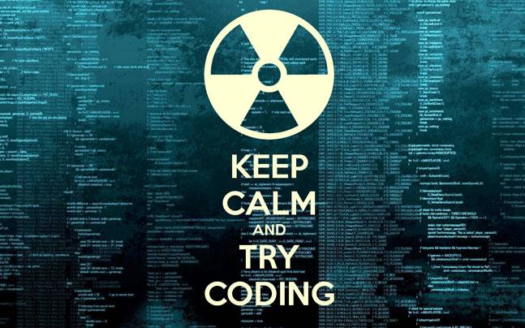
Generator and Iterator Demo
Simple Iterator
Simple Generator
Returning a value from a Generator
Passing values to a Generator
Delegating Generator
Simple example
Loops with delegation
Async generator

Slide 5
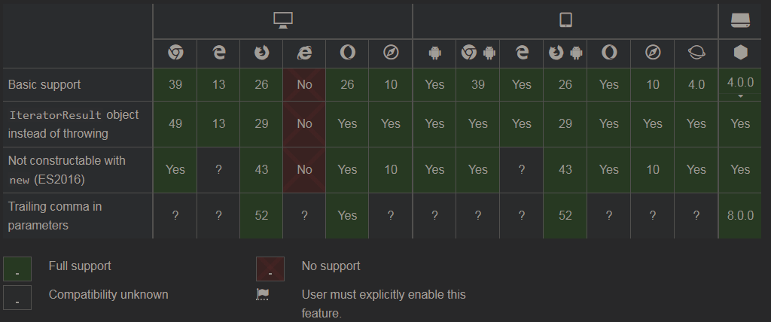
Browser compatibility

Slide 6

Redux-saga
Redux middleware for managing side-effects (used for making DB/API calls, etc.)
A “black box” that consumes and emits actions and/or side-effects
Similar to the messaging Saga pattern that we use on the backend – takes “events” and outputs “commands” to coordinate processes
Maintains continuously running processes (Sagas)
Used in conjunction with Generators
Effective for managing asynchronous operations
Advanced functionality – forking processes, yielding threads, etc.
Works both on the client- and server-side.
Available at https://github.com/redux-saga/redux-saga

Slide 7

Rationale (why not just use generators?)
Promises that are yielded inside generators still need to be called manually
When running generators with redux-saga, they are automatically wrapped and any promises are automatically resolved.
Any yield calls are automatically resolved and values are passed back into the generator
Makes async operations easier to handle and reason about

Slide 8

Redux-saga effects
Utility methods provided by Redux-Saga
Effects create plain objects that the saga interprets and executes processes based on them
Outside of a Redux-Saga context, effects do nothing
Types of effects:
Thread management | Action creation | Data seeding | Flow control
call | put | select | take
fork |  |  | takeEvery
spawn |  |  | takeLatest
apply
cancel

Slide 9

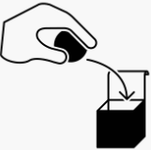
take
Pauses at a particular line of code waiting for a specified action to be dispatched
Execution resumes once the action is dispatched
Single-threaded
put
Dispatches an action
Virtually identical to calling dispatch. However, because it’s an action, it won’t dispatch an action unless it’s been called from inside a saga
Does not pause execution

Slide 10


call
Calls a method that is passed in
Execution is paused until the called method completes
Useful for testing as well
Fork
Very similar to Call in that it invokes a method that is passed in
Can’t capture the variables that are yielded from a forked method
Code continues to run without pausing
Dependent on the parent
If the parent errors or is cancelled, all forked processes are cancelled as well
Forked processes can use a finally block to check if they have been cancelled or the parent process has errored

Slide 11
takeevery
A combination of take and fork
Instead of taking an action once, it takes it every time it comes.
Every time it forks a new child process to handle that action
Execution is not paused

Slide 12
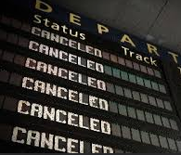

Cancel & cancelled
Cancel
Stops a forked process
The process can only be stopped at an yield statement – the next yield statement it gets to won’t continue
A forked process should have its logic surrounded by a try-finally block
When a forked process is cancelled, it’s finally block is invoked
When a process is cancelled, all processes forked off it are cancelled as well
Cancelled
A method that returns a true/false indicating whether the calling process has been cancelled
Usually used in a finally block to determine if the cancellation was deliberate (true) or the result of an error in the parent (false)

Slide 13

takeLatest
(couldn’t find an appropriate image, sorry)
A combination of fork, takeEvery and cancel
Every time an action is dispatched, a new process if forked off to handle it. Exactly one instance of the forked process is kept running
Sequence breakdown
An action is dispatched (user clicks a button)
A child process is forked and runs in its own thread
The same action is dispatched again (impatient user clicks the same button again)
The currently running forked process is cancelled
GOTO: 2.

Slide 14



select
Returns a copy of the application state when yielded to
If a selector is passed into select, the selector will be invoked
spawn
Similar to fork in that a new process is created
Execution is not paused
The new process is NOT a child of the caller
The new process will NOT be cancelled if the caller errors or is itself cancelled
Bonus points for having the coolest name

Slide 15

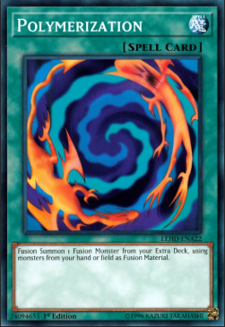
all
Combines multiple take statements into one
Execution pauses until all actions are dispatched
Returns an array of objects containing the action objects that were received
The order of actions does not matter
Putting it all together
A brief demo of using put, all, takeEvery, takeLatest, call, fork, spawn and cancel in a single saga.

Slide 16

Channels (very briefly)
Action channel
Buffers actions which the saga can consume one by one
Event channel
Wraps external event sources (like websockets)
Generic channel
Facilitates the communication between two sagas
The communication is private between the two sagas – any other saga would not receive any dispatched actions

Slide 17

Q & a
I would take ANY question on ANY topic
“Success is not final, failure is not fatal: it is the courage to continue that counts.” – Winston Churchill

Slide 18
Credits and references
Pluralsight
https://app.pluralsight.com/player?course=redux-saga&author=daniel-stern&name=3eae74b0-2935-42f6-9237-28f3de870728
JavaScript MDN
https://developer.mozilla.org/en-US/docs/Web/JavaScript/Reference/Statements/function*
https://developer.mozilla.org/en-US/docs/Web/JavaScript/Reference/Iteration_protocols#iterator
YouTube
https://www.youtube.com/watch?v=QO07THdLWQo
https://www.youtube.com/watch?v=lbBZXw2hKH4

